Slide 1
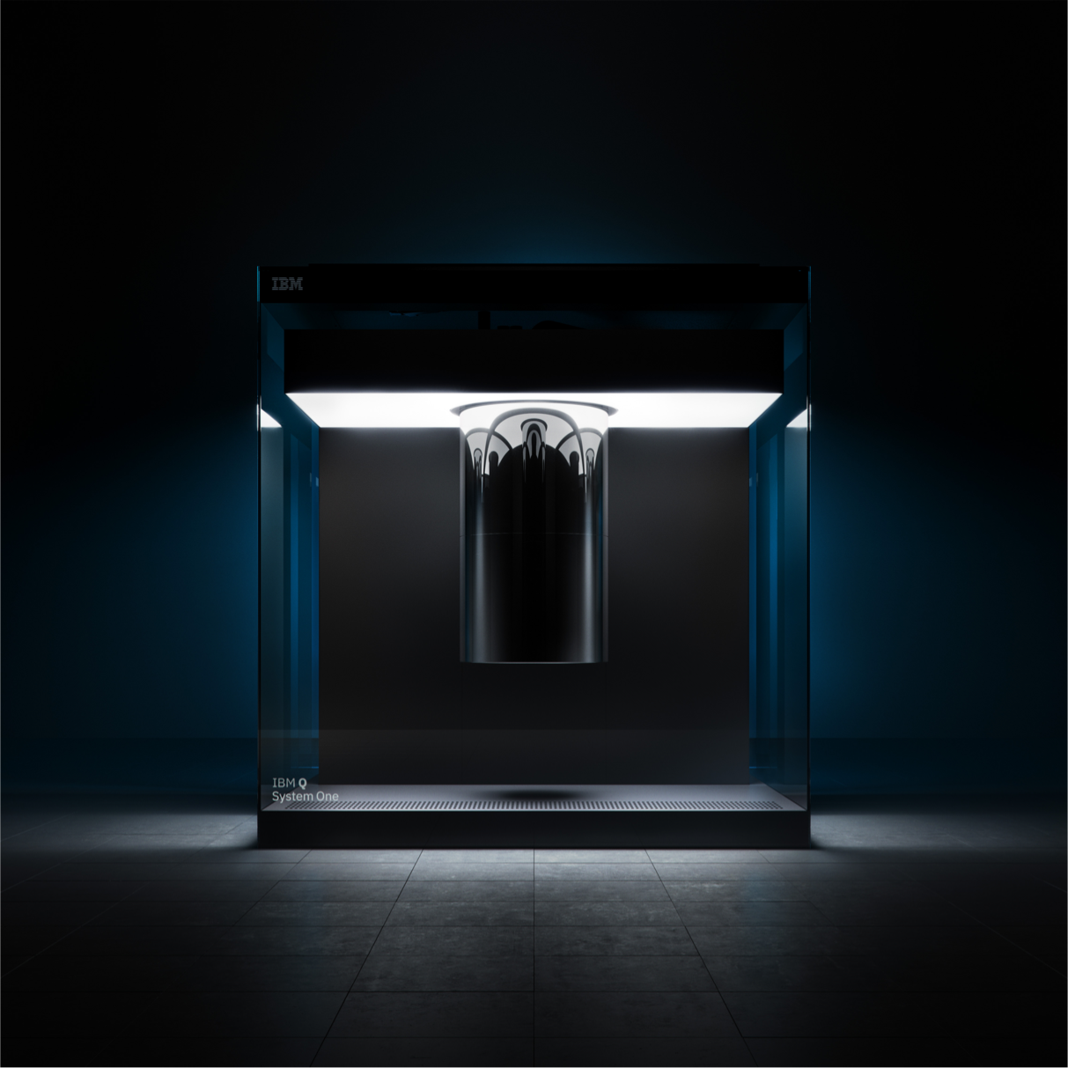
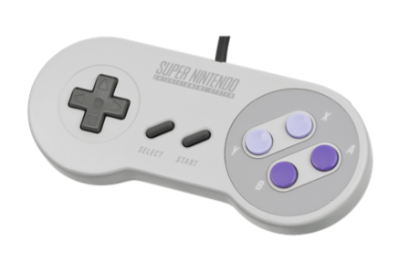
Games for Quantum Computers
James R. Wootton
IBM Research
Email Twitter
GitHub/Medium
jwo@zurich.ibm.com @decodoku @quantumjim

Slide 2
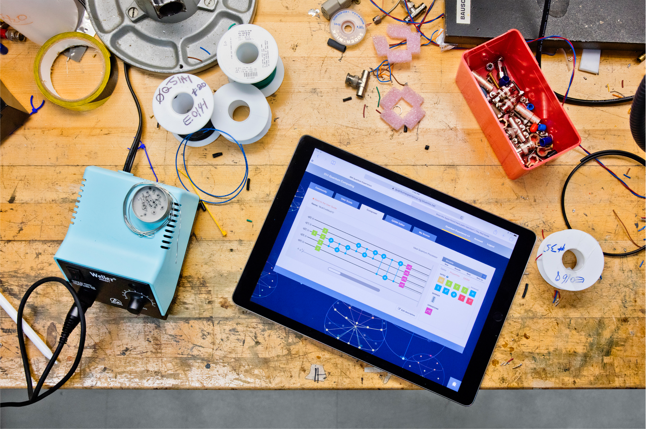

Games for today’s quantum computers

Slide 3
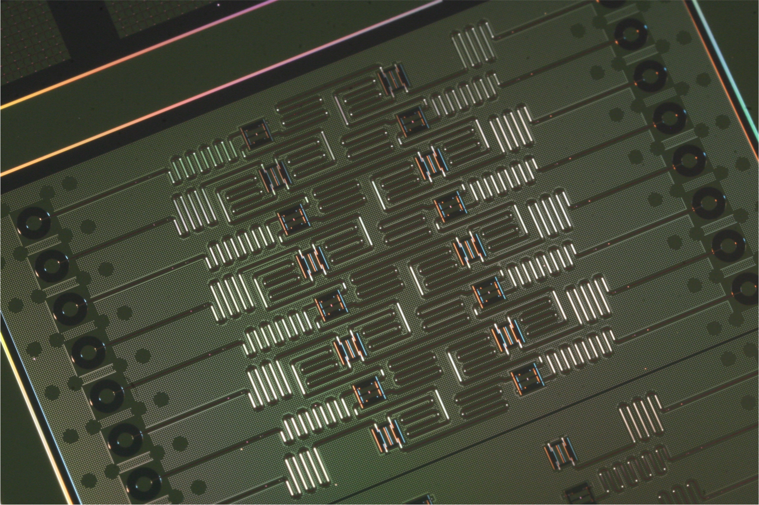
Current devices are small
50-100 qubits needed to do something that digital computers cannot
No more than 14 on devices currently usable by the public
Image: IBM Research

Slide 4
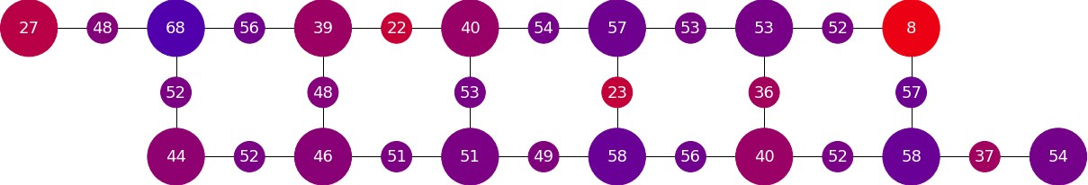
Current devices are noisy
Full error correction won’t be viable in the short term
Quantum programs will contain spurious effects
Program design and processing of readout need to mitigate this
Image: medium.com/qiskit

Slide 5
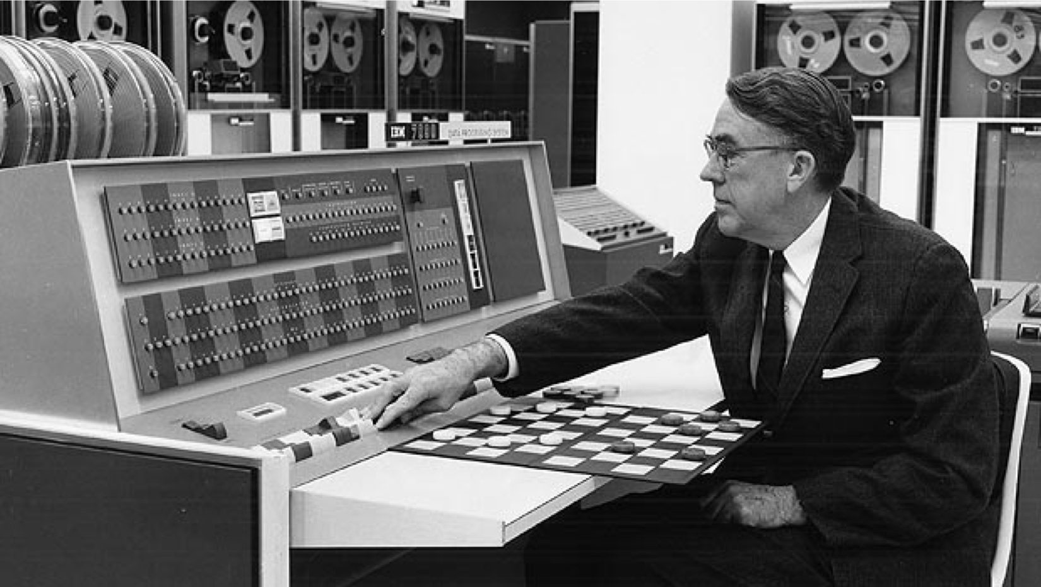
Quantum games are serious
Near-term quantum games will primarily be serious games
This parallels the serious games era of early gaming history
Image: www.ibm.com/ibm/history/ibm100/us/en/icons/ibm700series/impacts

Slide 6
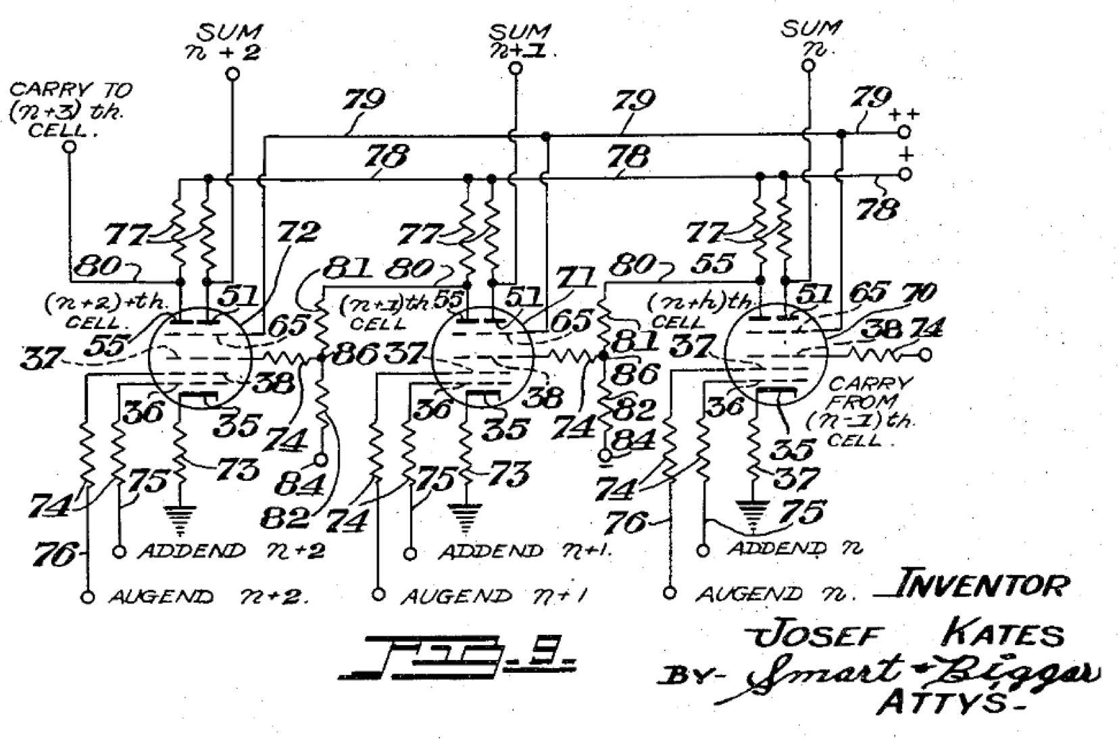
Bertie the Brain - 1950
Tic-Tac-Toe with vacuum tubes and light bulbs
Built to showcase a new vacuum tube design
Image: en.wikipedia.org/wiki/File:Additron_Tube_schematic.png

Slide 7
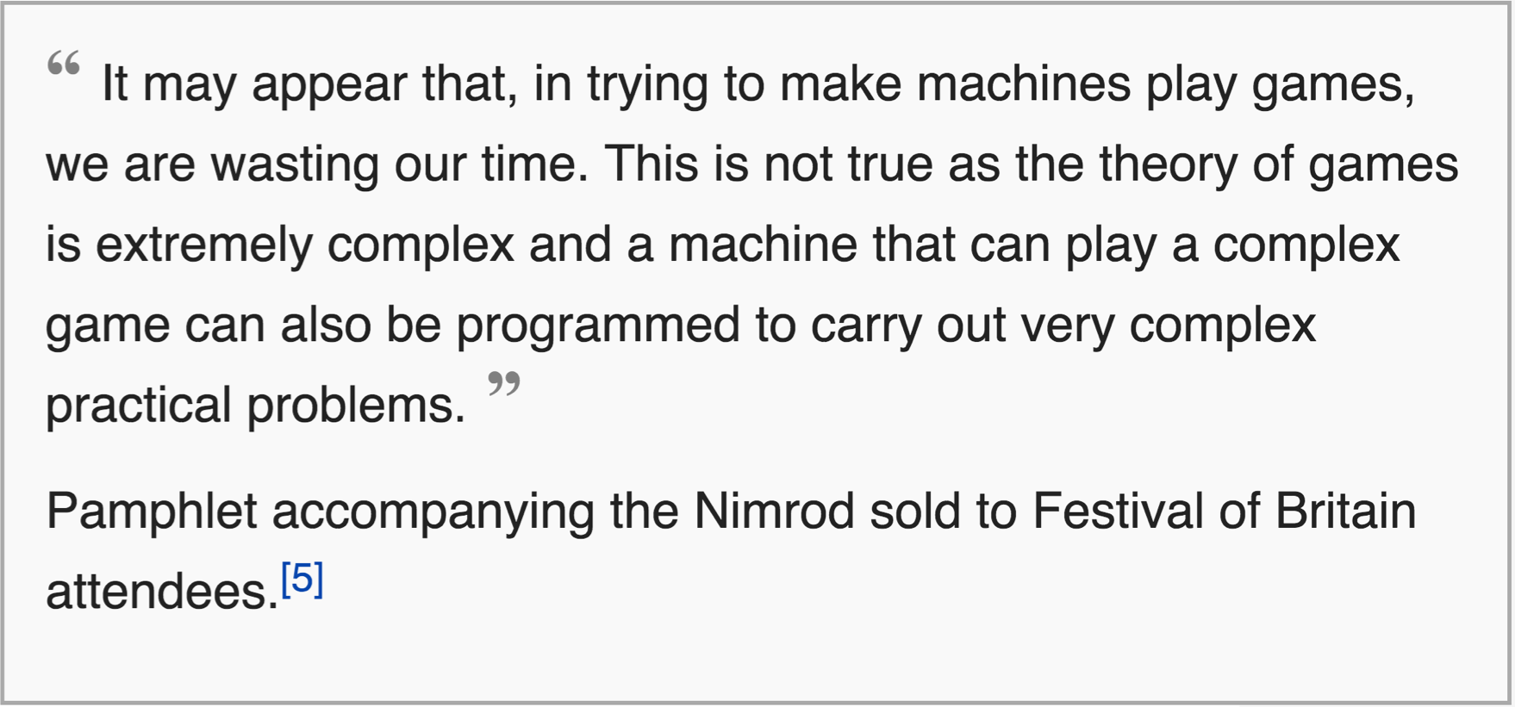
Nimrod - 1951
Nim with vacuum tubes and light bulbs
Built to “illustrate the algorithm and programming principles involved” (designer John Bennett)
For source of first quote, see en.wikipedia.org/wiki/Nimrod_(computer)
For source of second quote, see www.goodeveca.net/nimrod/bennett.html

Slide 8
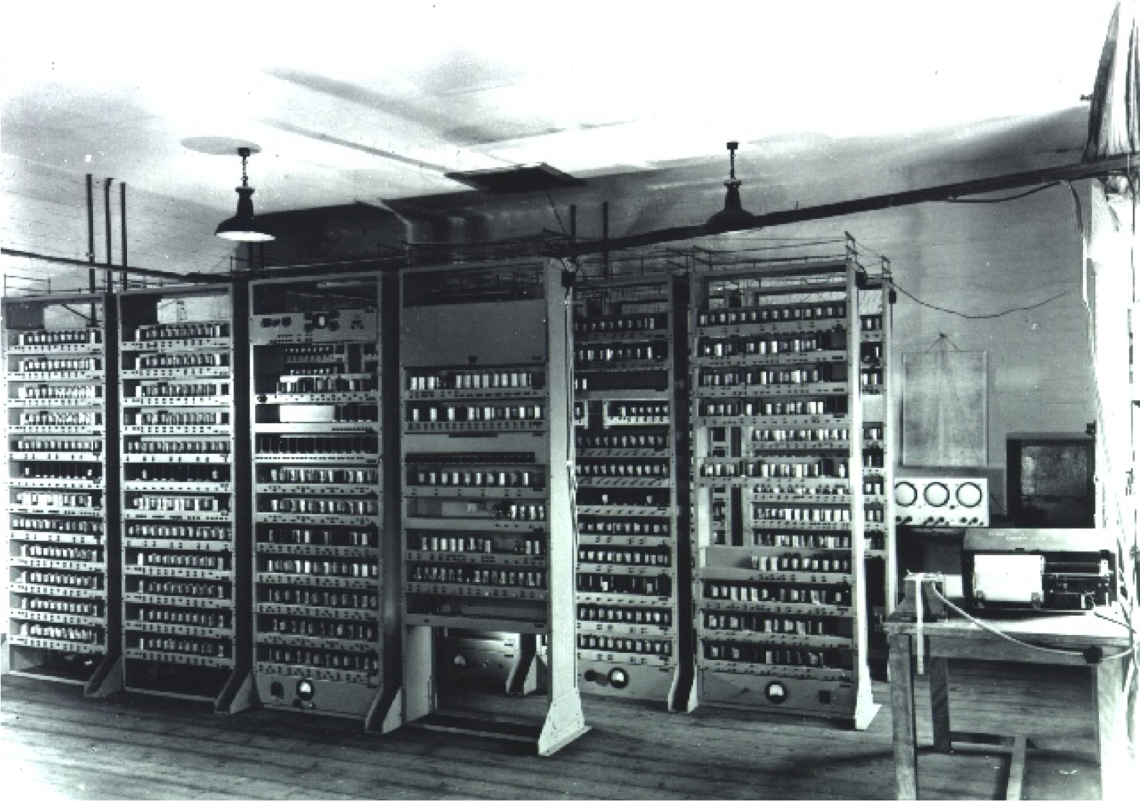
Noughts and Crosses (OXO) - 1952
Tic-Tac-Toe with vacuum tubes and cathode rays
Built for research into human-computer interaction
Image: commons.wikimedia.org/wiki/File:EDSAC_(19).jpg

Slide 9
IBM Checkers – 1950s
Checkers with AI on IBM 700 series
Built to demonstrate the power of computers (and raise IBM’s stock price)
Image: www.ibm.com/ibm/history/ibm100/us/en/icons/ibm700series/impacts

Slide 10
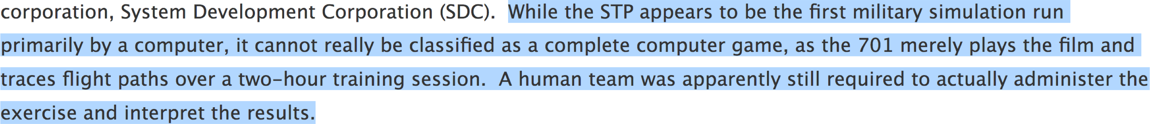
System Training Project – 1950’s
Military simulation (running on IBM hardware)
Built for training
Implemented game mechanic, but not game loop
Quote: videogamehistorian.wordpress.com/2014/01/22/the-priesthood-at-play-computer-games-in-the-1950s

Slide 11
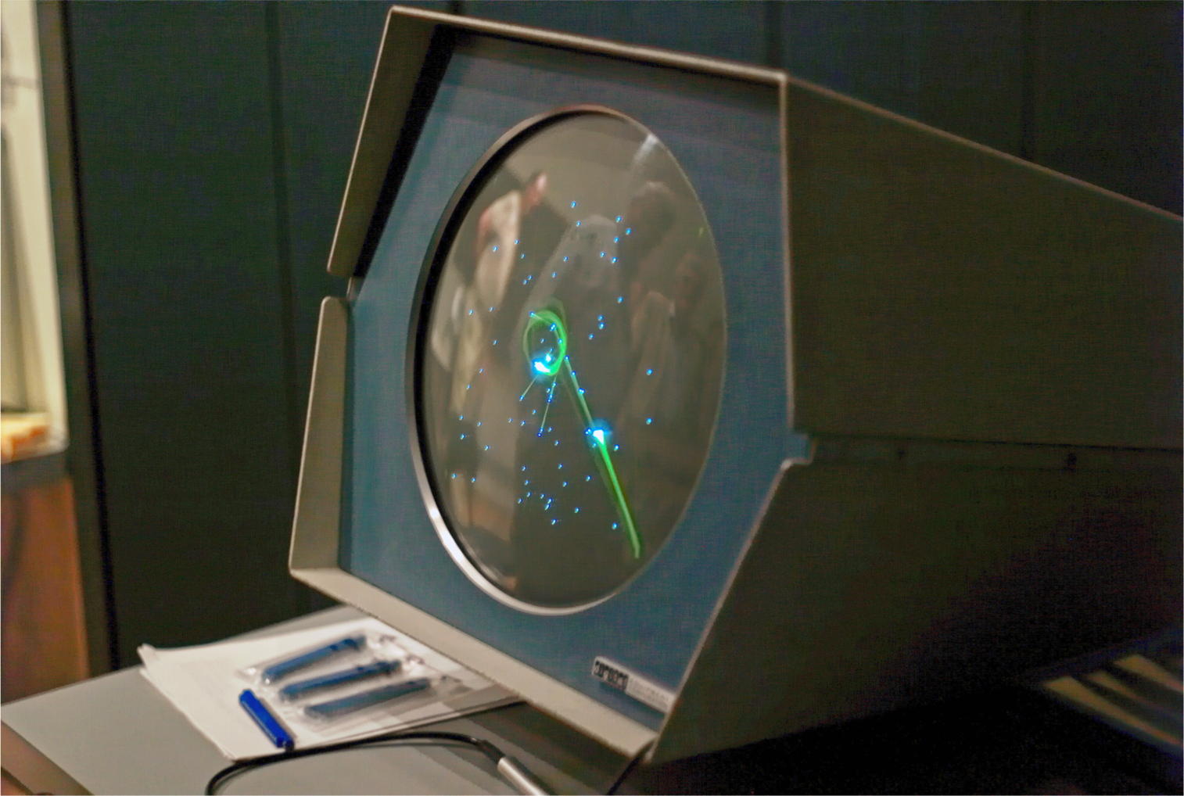
Spacewar! - 1962
First novel computer game, running on PDP-1
Built to
Test out a new device (and later, new installations)
Showcase its capabilities
Be fun!
Image: flickr.com/photos/35034362831@N01/494431001

Slide 12
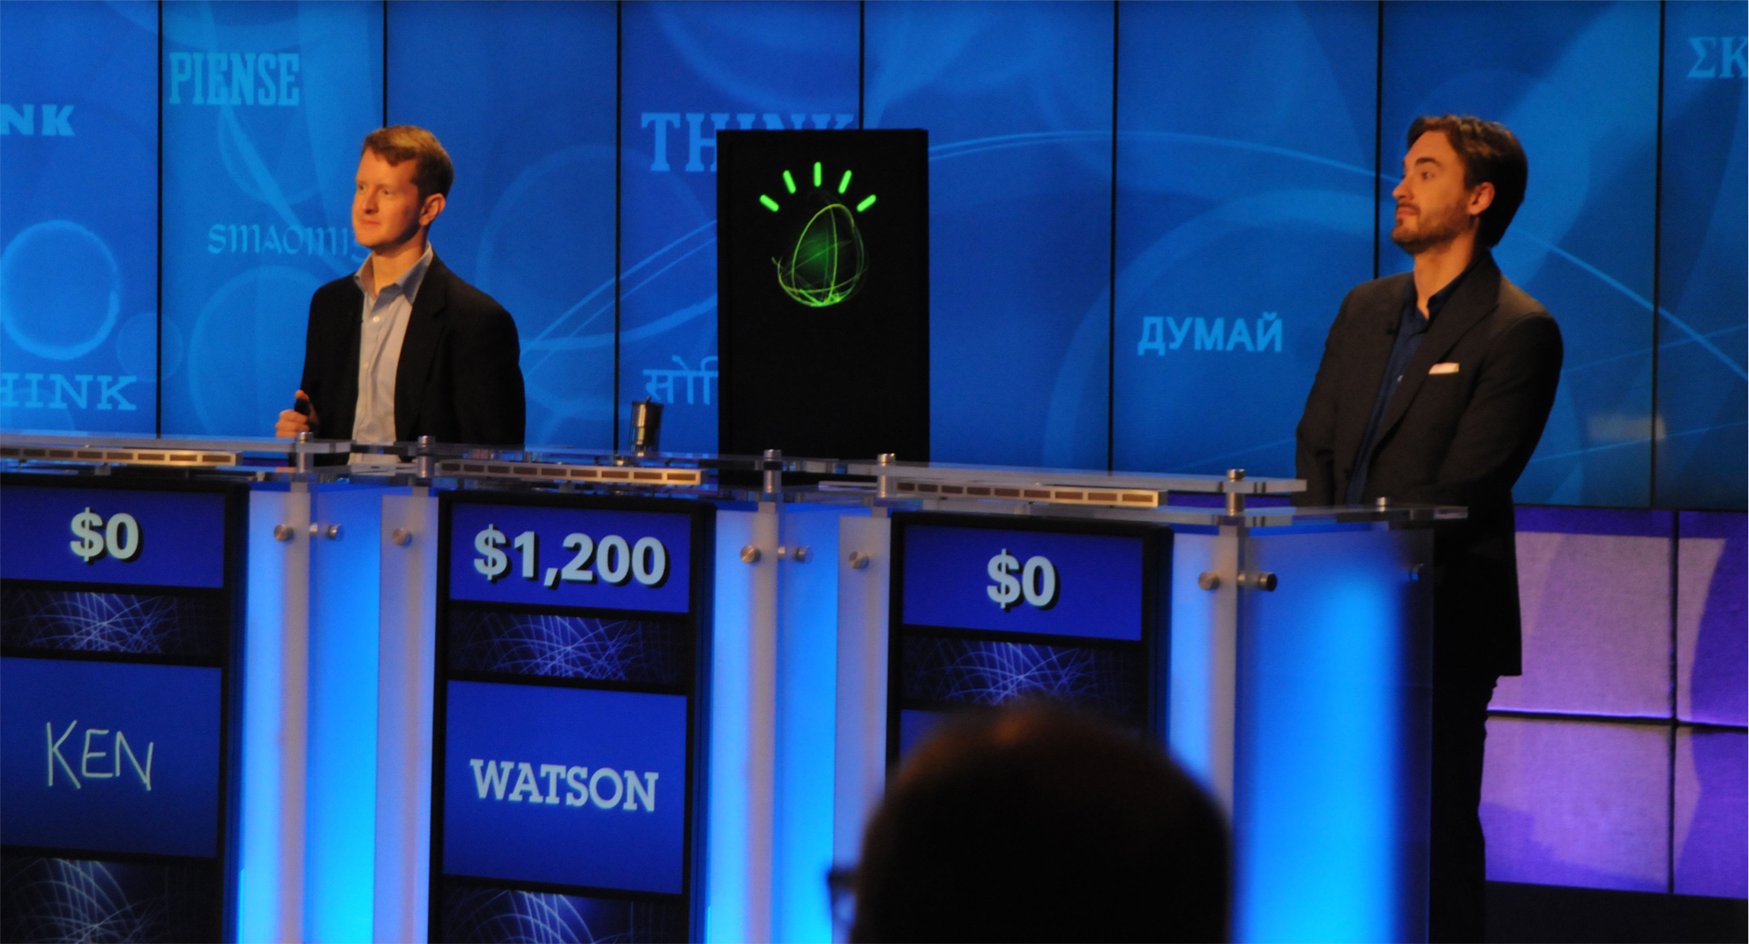
Deep Blue/Watson/AlphaGo - 1996-2016
AI playing games to demonstrate its power
Won against human champions of chess/Jeopardy!/go
commons.wikimedia.org/wiki/File:Watson_Jeopardy_demo.jpg

Slide 13
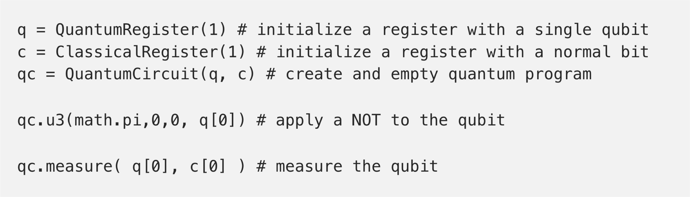
Quantum Battleships - 2017
Japanese-style Battleships built with partial NOT gates
Forms the heart of a simple quantum programming tutorial
Games to teach programmers:
Implement game mechanic with quantum operations
From medium.com/qiskit

Slide 14
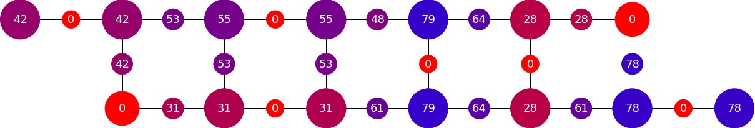
Quantum Awesomeness - 2017
Simple puzzle game of matching numbers
Game grid determined by instruction set
Difficulty determined by noise
Games to teach players:
Have gameplay influenced by device specs
Image: medium.com/qiskit

Slide 15
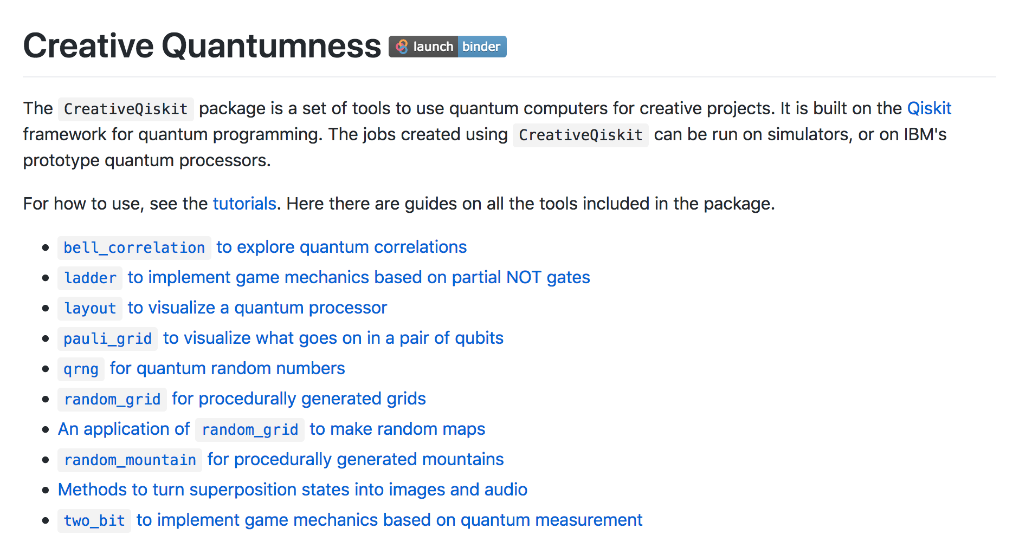
Ibm.biz/get-creative-qiskit

Slide 16
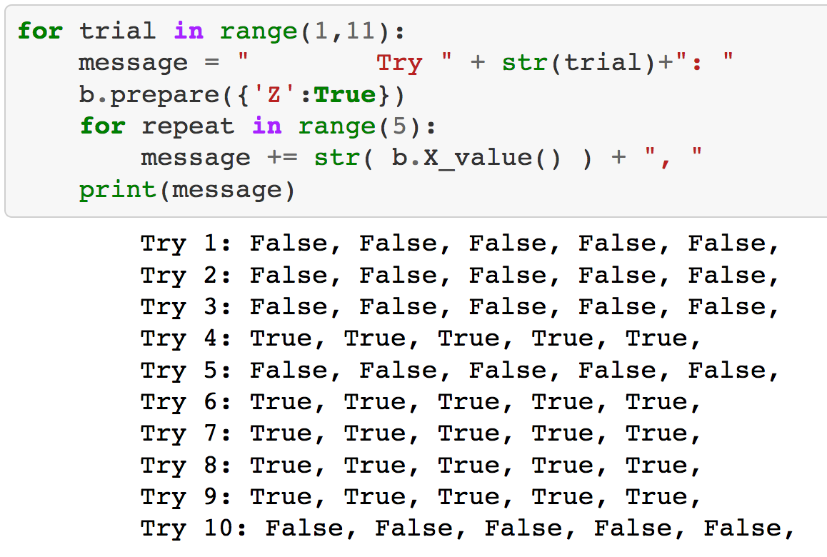
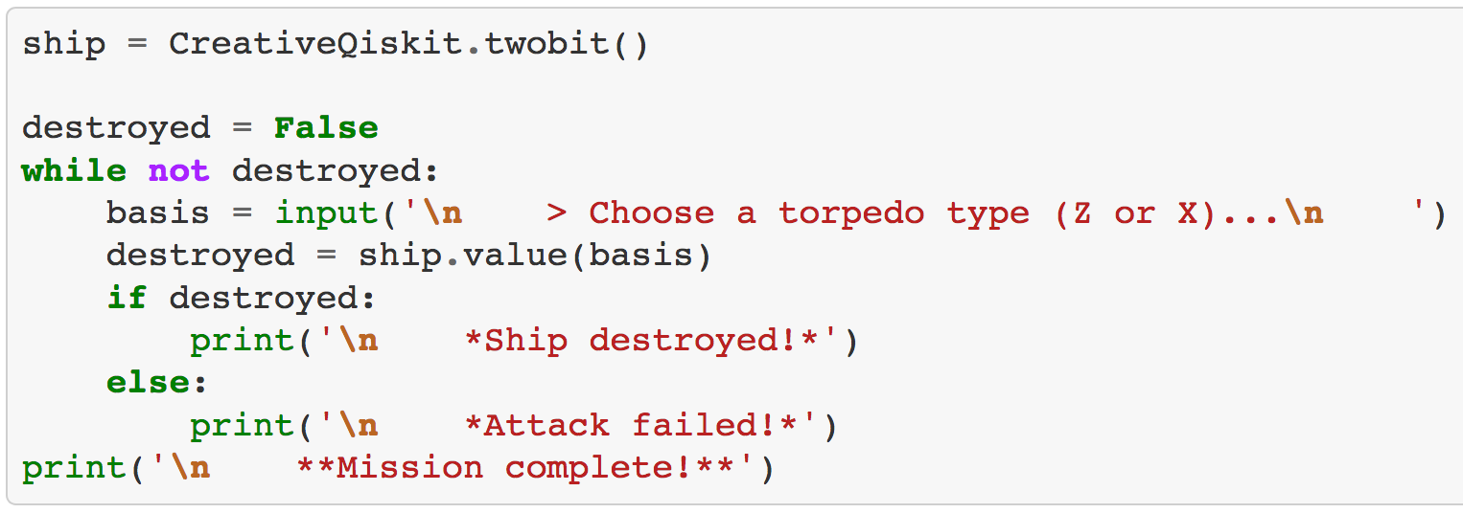
twobit
Helps us prepare |0 ⟩, |1 ⟩, |+ ⟩ and |- ⟩ states
Let’s us repeatedly measure in X, Y and Z bases
Allows a simple way to play with complementary measurements
Image: medium.com/qiskit

Slide 17
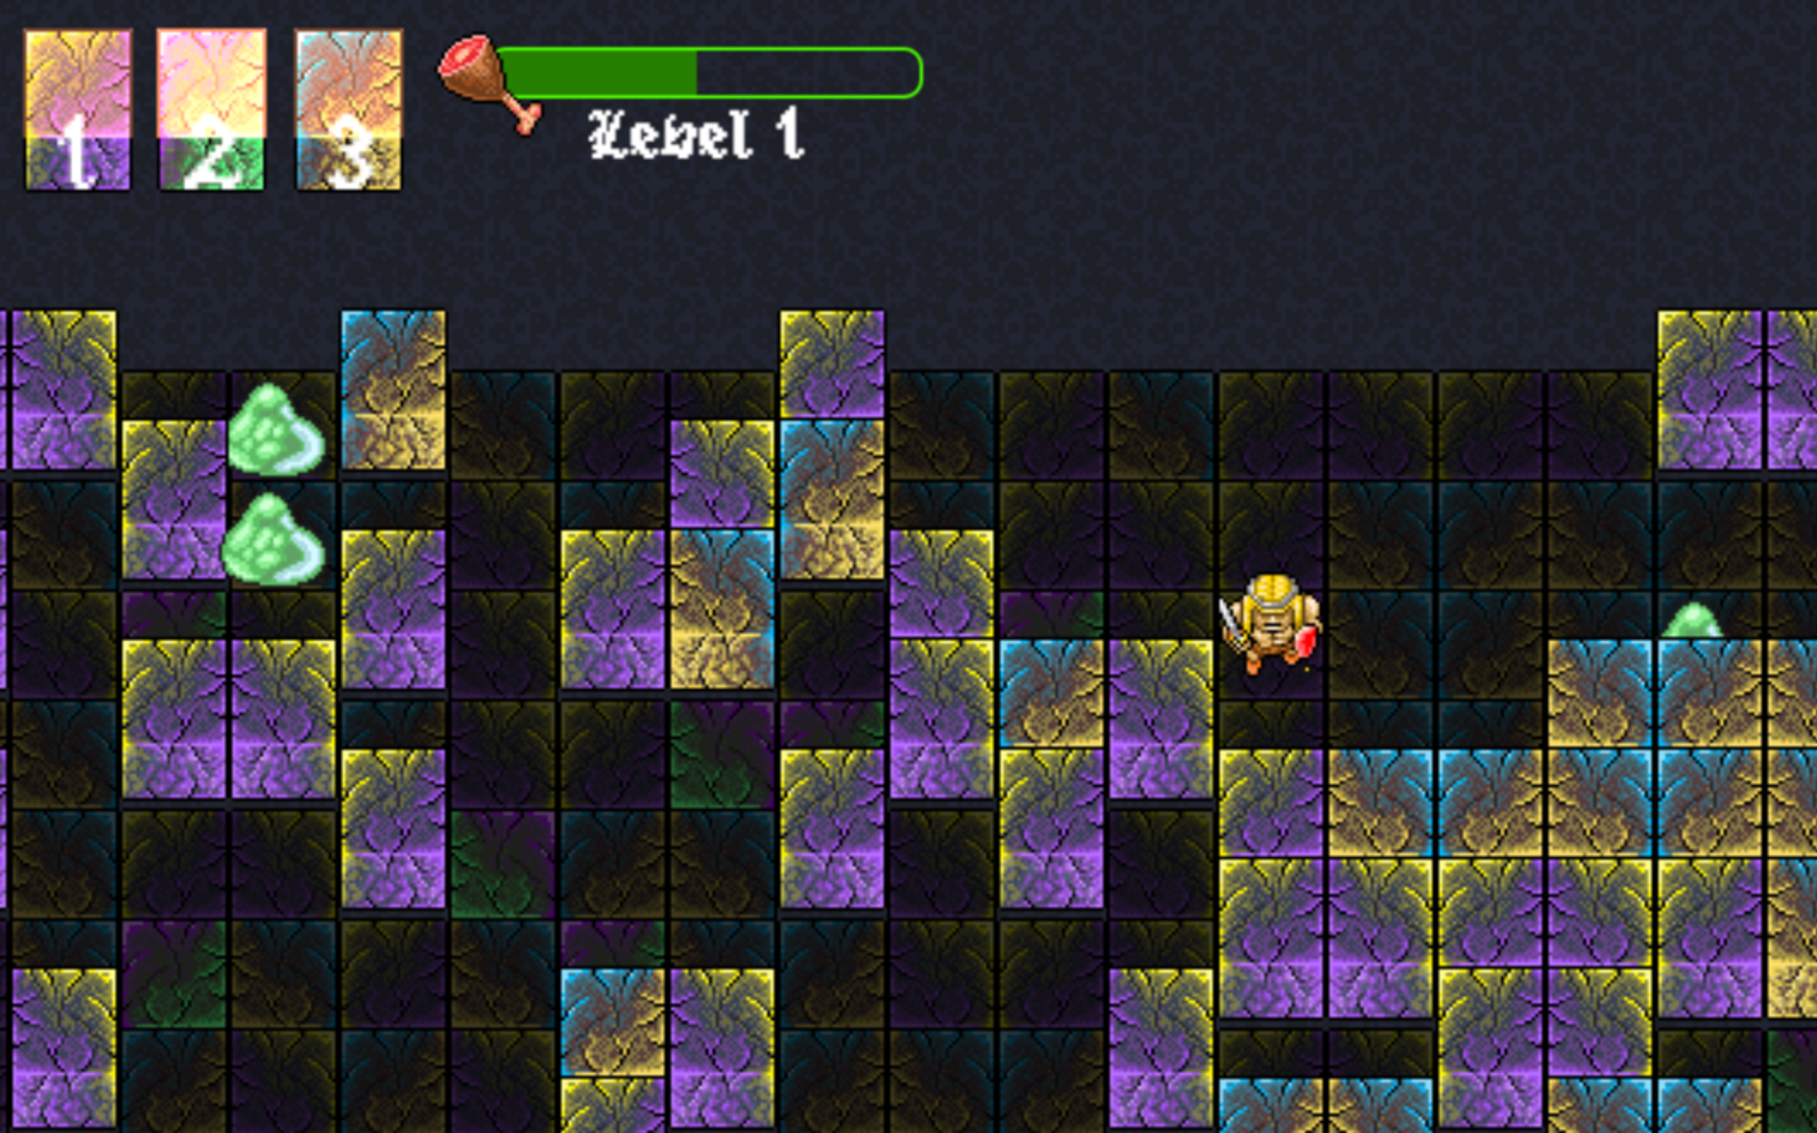
Qubit the Barbarian – 2018
Maze defined by qubit measurements
Player can measure neighbouring walls in X, Y and Z basis
Defeat monsters
Eat food
Escape!
Image: exca.itch.io/qubit-the-barbarian

Slide 18
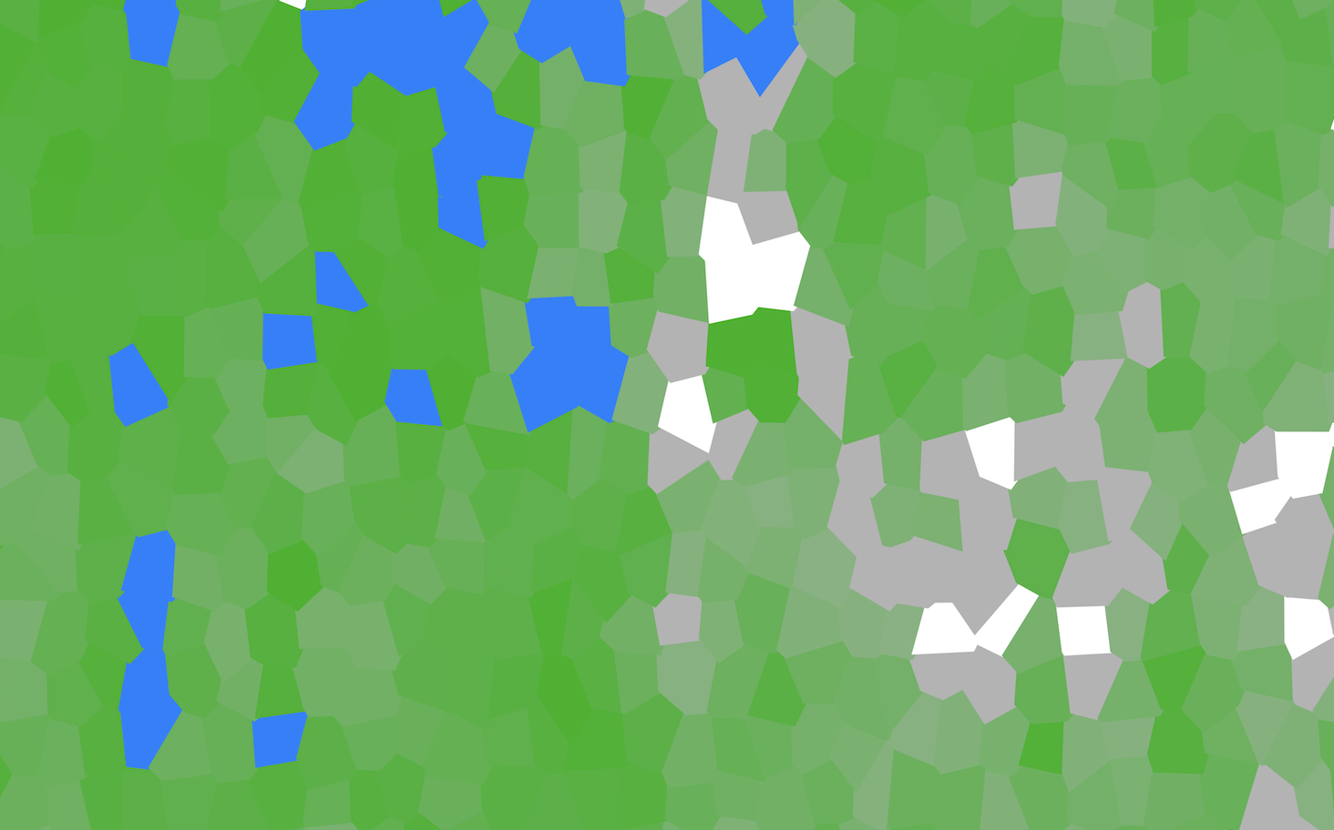
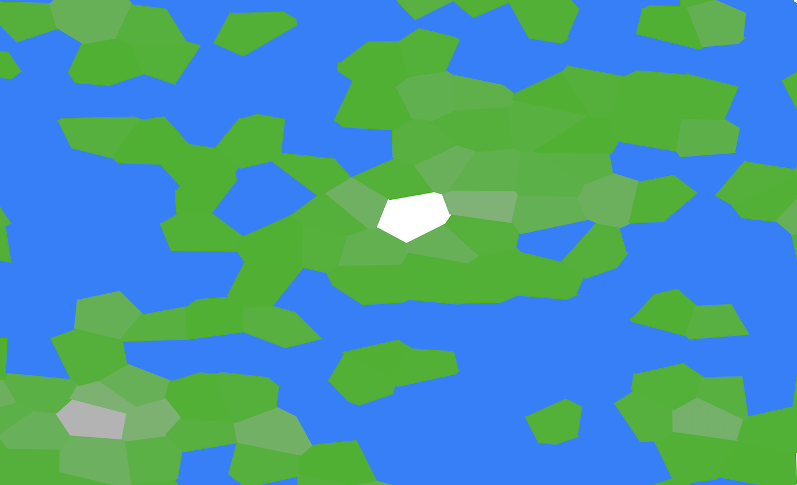
random_mountain
Pretty version of a histogram
Assign each output bit string with a position
Give it a colour based on value
Use it to make a map

Slide 19
Thanks for your attention
History of games for quantum computers
ibm.biz/qc-games
How to program quantum Battleships
ibm.biz/quantum-battleships
A gamified intro to basic QC concepts
ibm.biz/hello-qiskit
Tools for creative projects
ibm.biz/get-creative-qiskit
Email Twitter
GitHub/Medium
jwo@zurich.ibm.com @decodoku @quantumjim

